Slide 1
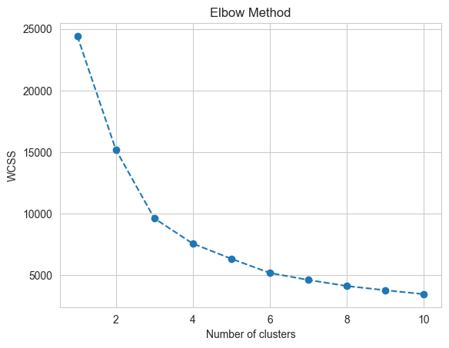
K-Means Clustering

Slide 2
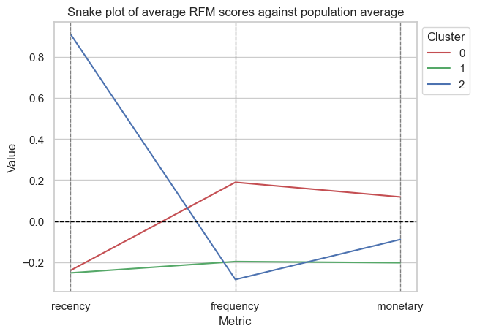
3 Clusters

Slide 3
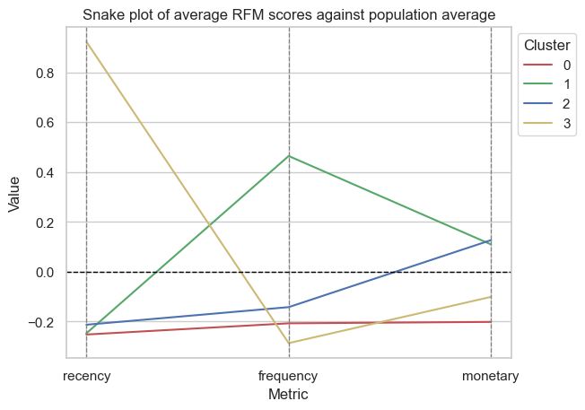
4 Clusters
Only 1 segment of customer (cluster 1) that spends more frequently on average.
This same customer segment has a higher monetary spend compared to the population average as with cluster 2.
Cluster 0 are low spenders who shop infrequently, less recently and lower average spend compared to the population average.
Cluster 3 segment of customers – spent very recently i.e. towards end of the year but less frequently overall and with lower average spend.

Slide 4
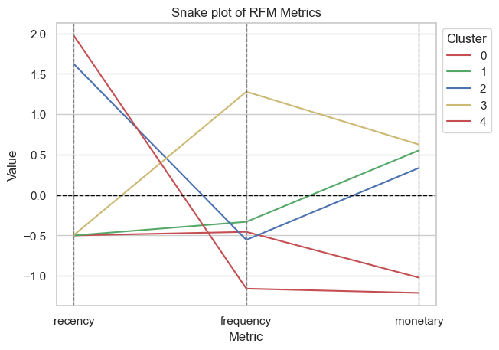
5 Clusters

Slide 5
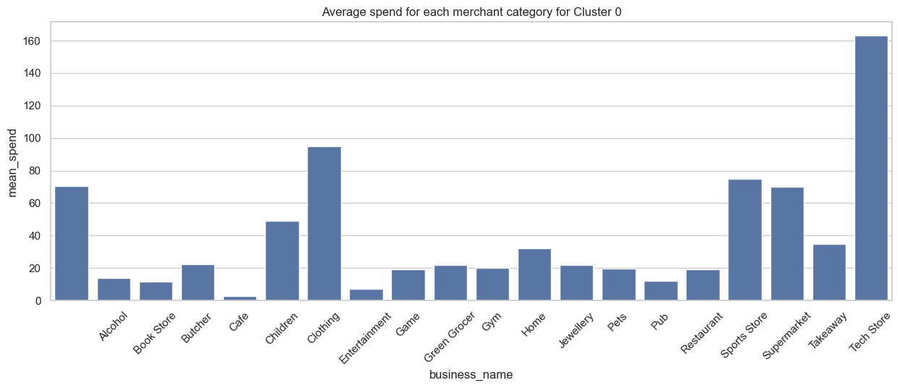
Spending behaviours for each customer segment

Slide 6
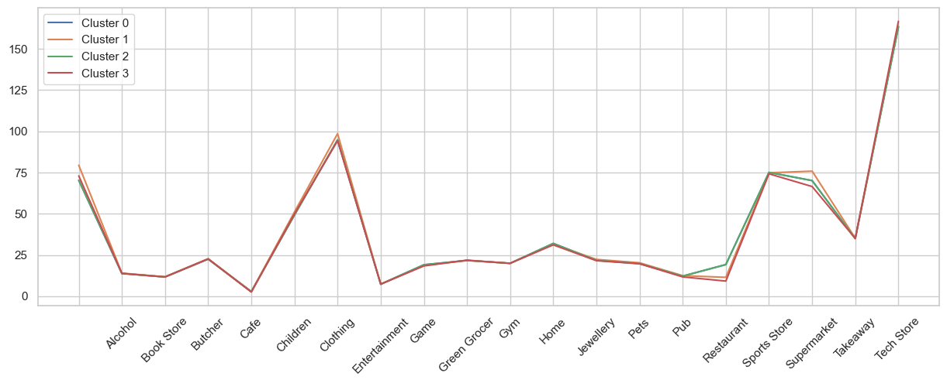
Spending behaviours for each customer segment

